Slide 1
Intro to Java
A Modern Language

Slide 2
A Modern Language
We want software that works—consistently, anywhere, on any platform—and that plays well with other applications.
We want dynamic applications that take advantage of a connected world, capable of accessing disparate and distributed information sources.
We want truly distributed software that can be extended and upgraded seamlessly.
We have known for some time what kind of software we want, but it is really only in the past few years that we have begun to get it.

Slide 3
Java’s Lineage
Java is related to C++, which is a direct descendant of C.
Much of the character of Java is inherited from these two languages.
From C, Java derives its syntax.
Many of Java’s object-oriented features were influenced by C++.

Slide 4
The Birth of Modern Programming - C
The C language shook the computer world. It fundamentally changed the way programming was approached and thought about.
The creation of C was a direct result of the need for a structured, efficient, high-level language that could replace assembly code when creating systems programs.
Early computer languages such as BASIC, COBOL, and FORTRAN were not designed around structured principles. Instead, they relied upon the GOTO as a primary means of program control.
As a result, programs written using these languages tended to produce “spaghetti code”—a mass of tangled jumps and conditional branches that make a program virtually impossible to understand.

Slide 5
The Creation of C
C was invented and first implemented by Dennis Ritchie on a DEC PDP-11 running the UNIX operating system.
The creation of C is considered by many to have marked the beginning of the modern age of computer languages.
The result was a powerful, efficient, structured language that was relatively easy to learn.
It also included one other, nearly intangible aspect: it was a programmer’s language. It was designed, implemented, and developed by real, working programmers, reflecting the way that they approached the job of programming.

Slide 6
The Next Step – C++
During the late 1970s and early 1980s, C became the dominant computer programming language, and it is still widely used today.
Although C is one of the world’s great programming languages, there is a limit to its ability to handle complexity. Once the size of a program exceeds a certain point, it becomes so complex that it is difficult to grasp as a totality.
C++ was invented by Bjarne Stroustrup in 1979, at Bell Laboratories in New Jersey. C++ extends C by adding object-oriented features.
Because C++ is built on the foundation of C, it includes all of C’s features, attributes, and benefits. The invention of C++ was not an attempt to create a completely new programming language. Instead, it was an enhancement to an already highly successful one.

Slide 7
The Stage is Set for Java
By the end of the 1980s and the early 1990s, object-oriented programming using C++ took hold. It seemed as if programmers had finally found the perfect language. Because C++ blended the high efficiency and stylistic elements of C with the object-oriented paradigm, it was a language that could be used to create a wide range of programs.
However, just as in the past, forces were brewing that would, once again, drive computer language evolution forward. Within a few years, the World Wide Web and the Internet would reach critical mass. This event would precipitate another revolution in programming.

Slide 8
The Creation of Java
Java was conceived by James Gosling, Patrick Naughton, Chris Warth, Ed Frank, and Mike Sheridan at Sun Microsystems, Inc., in 1991.
It took 18 months to develop the first working version. This language was initially called “Oak,” but was renamed “Java” in 1995.
Between the initial implementation of Oak in the fall of 1992 and the public announcement of Java in the spring of 1995, many more people contributed to the design and evolution of the language.
Bill Joy, Arthur van Hoff, Jonathan Payne, Frank Yellin, and Tim Lindholm were key contributors to the maturing of the original prototype.

Slide 9
Motivation for Java
The primary motivation was the need for a platform-independent (that is, architecture-neutral) language that could be used to create software to be embedded in various consumer electronic devices, such as microwave ovens and remote controls.
The second force was the World Wide Web. Had the Web not taken shape at about the same time that Java was being implemented, Java might have remained a useful but obscure language for programming consumer electronics.

Slide 10
History of Java, pt 1
In the early 1990's, putting intelligence into home appliances was thought to be the next "hot" technology.
Examples of intelligent home appliances:
Coffee pots and lights that can be controlled by a computer's programs.
Televisions that can be controlled by an interactive programmable device
Anticipating a strong market for such things, Sun Microsystems in 1991 funded a research project (code named Green) whose goal was to develop software for intelligent home appliances.

Slide 11
History of Java, pt 2
Originally, Sun planned to use C++for its home appliance software, but realized C++ was not sufficiently portable.
Thus, rather than write C++ software and fight C++'s inherent deficiencies, Sun decided to develop a whole new programming language to handle its home appliance software needs.
Their new language was originally named Oak (for the tree that was outside project leader James Gosling's window), but it was soon changed to Java.
When the home appliance software work dried up, Java almost died before being released.

Slide 12
History of Java, pt 3
Fortunately for Java, the World Wide Web exploded in popularity and Sun realized it could participate because Web pages have to be very portable to be downloaded onto any type of computer.
Java’s first release was in 1995.
Netscape, the world’s most popular browser manufacturer at that time, incorporated Java in its software, and Java took off.
Prior to Java, communication was only from the web pages to the user. When the web community figured out how to embed Java programs inside web pages, the user experience became much more interactive and enjoyable.

Slide 13
The C# Connection
Perhaps the most important example of Java’s influence is C#. Created by Microsoft to support the .NET Framework, C# is closely related to Java.
Both share the same general syntax, support distributed programming, and utilize the same object model.
The overall “look and feel” of these languages is very similar.
This “cross-pollination” from Java to C# is the a testimonial that Java redefined the way we think about and use a computer language.

Slide 14
Change of Ownership
In 2010, Oracle corporation bought Sun Microsystems and became the steward of the Java language.
In July of 2011, Oracle released Java SE 7, a significant Java release including a new I/O package in 2017. Then came Java 9.
Oracle continues to lead Java development; however, they have also bifurcated the Java world by moving the main Java deployment environment to a costly commercial license and offering a free subsidiary OpenJDK option that retains the accessibility many developers love and expect.

Slide 15
JRE OR JDK?
What is the difference between a JRE and a JDK?
Up until now, we have only been talking about "Java". But what is Java exactly? First, you need to differentiate between a JRE (Java Runtime Environment) and a JDK (Java Development Kit).
Historically, you downloaded just a JRE if you were only interested in running Java programs. A JRE includes, among other things, the Java Virtual Machine (JVM) and the "java" command line tool.
To develop new Java programs, you needed to download a JDK. A JDK includes everything the JRE has, as well as the compiler javac and a couple of other tools like javadoc (Java documentation generator) and jdb (Java Debugger).

Slide 16
Why in the Past Tense?
Up until Java 8, the Oracle website offered JREs and JDKs as separate downloads - even though the JDK also always included a JRE in a separate folder.
With Java 9 that distinction was basically gone, and you are always downloading a JDK. The directory structure of JDKs also changed, with not having an explicit JRE folder anymore.

Slide 17
Licensing
The Binary Code License for Oracle Java SE technologies (“BCL”) has been the primary license for Oracle Java SE for well over a decade.
The BCL permits use without license fees under certain conditions.
To simplify things going forward, Oracle started providing open source licensed OpenJDK builds as of Java 9, using the same license model as the Linux platform.

Slide 18
The Result
From Java 11 forward, therefore, Oracle JDK builds and OpenJDK builds will be essentially identical...yet with some cosmetic and packaging differences.
The difference that we need to notice is that OpenJDK does not contain the Java FX modules. They are available under the OpenJFX.
So we will begin by installing Java using OpenJDK and use that with Notepad++ for our first three programs.
Then we will install Scenebuilder with Java FX. It provide JavaFX for us.
The latest version of Java OpenJDK is 23.

Slide 19
Java Security and Portability
As you are likely aware, every time you download a “normal” program, you are taking a risk, because the code you are downloading might contain a virus, Trojan horse, or other harmful code.
Java achieved this protection by enabling you to confine an application to the Java execution environment and prevent it from accessing other parts of the computer.
Portability is a major aspect of the Internet because there are many different types of computers and operating systems connected to it.
The same application code must work on all computers. As you will soon see, the same mechanism that helps ensure security also helps create portability.

Slide 20
The Java Virtual Machine and Bytecode

Slide 21
Bytecode
The key that allowed Java to solve both the security and the portability problems is that the output of a Java compiler is not executable code.
Rather, it is bytecode. Bytecode is a highly optimized set of instructions designed to be executed by what is called the Java Virtual Machine (JVM), which is part of the Java Runtime Environment (JRE).
In essence, the original JVM was designed as an interpreter for bytecode. This may come as a bit of a surprise since many modern languages are designed to be compiled into executable code because of performance concerns.
However, the fact that a Java program is executed by the JVM helps solve the major problems associated with web-based programs.

Slide 22
Bytecode, continued
Translating a Java program into bytecode makes it much easier to run a program in a wide variety of environments because only the JVM needs to be implemented for each platform. Once a JRE exists for a given system, any Java program can run on it.
The fact that a Java program is executed by the JVM also helps to make it secure. Because the JVM is in control, it manages program execution. Thus, it is possible for the JVM to create a restricted execution environment, called the sandbox, that contains the program, preventing unrestricted access to the machine.

Slide 23
HotSpot
The HotSpot provides a just-in-time (JIT) compiler for bytecode.
When a JIT compiler is part of the JVM, selected portions of bytecode are compiled into executable code in real time, on a piece-by-piece, demand basis.
It is important to understand that an entire Java program is not compiled into executable code all at once. Instead, a JIT compiler compiles code as it is needed.

Slide 24
The Virtual Machine
The result is that Java is both a compiled and an interpreted language.
Java source code is turned into simple binary instructions, much like ordinary microprocessor machine code.
However, whereas C or C++ source is reduced to native instructions for a particular model of processor, Java source is compiled into a universal format—instructions for a virtual machine (VM).

Slide 25
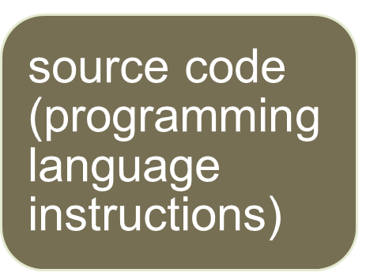
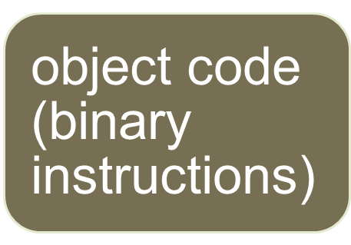
The Compilation Process for Non-Java Programs
Programmers write this.
Compilers compile source code into object code.
Computers run this.

Slide 26
Object Code
Object code is a set of binary-format instructions that can be directly run by a computer to solve a problem.
A binary instruction is made up of all 0’s and 1’s, because that’s what computers understand. Here's an example of an object-code instruction:
      0100001111101010
This particular object-code instruction is referred to as a 16-bit instruction because each of the 0’s and 1’s is a bit, and there are 16 of them.

Slide 27
Machine Code
Programmers sometimes refer to object code as machine code.
Object code is called machine code because it's written in binary and that's what a computer “machine” understands.
Each object-code instruction is in charge of only a simple computer task.
For example, an object-code instruction could possibly be in charge of copying a single number from some place in main memory to some place in the CPU.

Slide 28
Portability
A piece of software is portable if it can be used on many different types of computers.
Object code is not very portable. It is comprised of binary-format instructions.
Those binary-format instructions are tied to a particular type of computer.
Object code that was created on a type X computer can run only on a type X computer.
This is not portable!

Slide 29
Java’s Solution to Portability
Java compilers compile down to bytecode, which possesses the best features of both object code and source code:
Like object code, bytecode uses a format that works closely with computer hardware, so it runs fast.
Like source code, bytecode is generic, so it can be run on any type of computer.

Slide 30
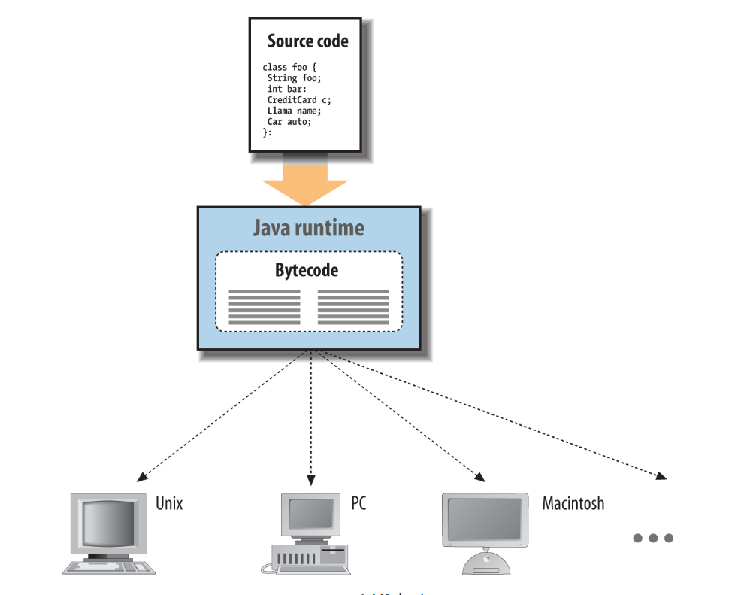
JAVA

Slide 31
How can bytecode be run on any computer?
As a Java program’s bytecode runs, the bytecode is translated into object code by the computer's bytecode interpreter program.
The bytecode interpreter program is known as the Java virtual machine, or JVM for short.
JVM translates bytecode to object code.

Slide 32
The Class
The fundamental unit of Java code is the class.
As in other object-oriented languages, classes are application components that hold executable code and data.
Compiled Java classes are distributed in a universal binary format that contains Java bytecode and other class information.
A function in a class is called a method.

Slide 33
Native methods
Java has a number of fundamental classes that contain architecture-dependent methods.
These native methods serve as the gateway between the Java virtual machine and the real world.
The vast majority of Java is written in Java itself and is therefore portable.
This includes fundamental Java tools such as the Java compiler, networking, and GUI libraries, which are also written in Java and are therefore available on all Java platforms in exactly the same way without porting.

Slide 34
Safety of Design
You have no doubt heard a lot about the fact that Java is designed to be a safe language. But what do we mean by safe? Safe from what or whom?
The security features that attract the most attention for Java are those features that make possible new types of dynamically portable software.
Perhaps more important than specific security features, is the safety that Java provides by addressing common design and programming problems.

Slide 35
Java Simplifies
Java provides a well-defined package structure for organizing class files. The package system allows the compiler to handle some of the functionality of the traditional make utility (a tool for building executables from source code).
Java also takes a different approach to some structural features that have been troublesome in other languages.
Interfaces in Java eliminate the need for multiple inheritance of classes and the associated problems.

Slide 36
Type Safety and Method Binding
Every object in Java has a well-defined type that is known at compile time. This means the Java compiler can do the same kind of static type checking and usage analysis as C++.
However, Java is fully runtime-typed as well. The Java runtime system keeps track of all objects and makes it possible to determine their types and relationships during execution.
Casts from one type of object to another are checked by the runtime system, and it’s possible to use new kinds of dynamically loaded objects with a degree of type safety.

Slide 37
Dynamic Memory Management
Java adds object garbage collection and high-level arrays to the language. These features eliminate many otherwise insurmountable problems with safety, portability, and optimization.
Java uses a sophisticated garbage collector that runs in the background, which means that most garbage collecting takes place during idle times, between I/O pauses, mouse clicks, or keyboard hits.

Slide 38
Error Handling
Java has a powerful exception-handling mechanism, somewhat like that in newer implementations of C++.
Exceptions provide a more natural and elegant way to handle errors.
Exceptions allow you to separate error-handling code from normal code, which makes for cleaner, more readable applications.
The Java compiler requires that a method either declare the exceptions it can generate or catch and deal with them itself.

Slide 39
Threads
Modern applications require a high degree of parallelism.
Even a very single-minded application can have a complex user interface—which requires concurrent activities.
Threads provide efficient multiprocessing and distribution of tasks for both client and server applications.
Java has a high-level concurrency package that provides powerful utilities addressing common patterns in multithreaded programming, such as thread pools, coordination of tasks, and sophisticated locking.

Slide 40
Scalability
At the lowest level, Java programs consist of classes. Classes are intended to be small, modular components.
Over classes, Java provides packages, a layer of structure that groups classes into functional units.
Packages provide a naming convention for organizing classes and a second tier of organizational control over the visibility of variables and methods in Java applications.
This lends itself to building reusable components that work together in a system.

Slide 41
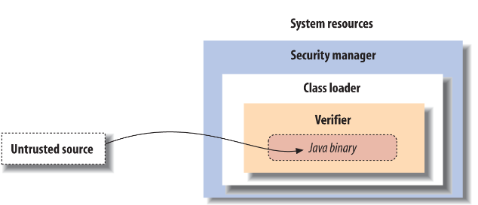
Safety of Implementation
The Java security model wraps three layers of protection around imported classes, as shown:

Slide 42
More on Safety
Application-level security decisions are made by a security manager in conjunction with a flexible security policy.
A security manager controls access to system resources such as the filesystem, network ports, and windowing environment.
The Java bytecode verifier is a special module and a fixed part of the Java runtime system.

Slide 43
The Verifier
Java’s first line of defense is the bytecode verifier.
The verifier reads bytecode before it is run and makes sure it is well-behaved and obeys the basic rules of the Java bytecode specification.
Once code has been verified, it’s considered safe from certain inadvertent or malicious errors.
For example, verified code can’t forge references or violate access permissions on objects

Slide 44
Class Loaders
Java adds a second layer of security with a class loader.
A class loader is responsible for bringing the bytecode for Java classes into the interpreter.
Every application that loads classes from the network must use a class loader to handle this task.
Classes retrieved from a specific source can be restricted to interact only with other classes retrieved from that same location.

Slide 45
Security Managers
A security manager is responsible for making application-level security decisions.
A security manager is an object that can be installed by an application to restrict access to system resources.
The security manager is consulted every time the application tries to access items such as the filesystem, network ports, external processes, and the windowing environment; the security manager can allow or deny the request.
The integrity of a security manager is based on the protection afforded by the lower levels of the Java security model.
Without the guarantees provided by the verifier and the class loader, high-level assertions about the safety of system resources are meaningless

